Slide 1
Sample Output
(and other things)

Slide 2
Boss
int floor
int ceiling
ActionNode* FirstAction
DecisionTreeNode* left
DecisionTreeNode* right
char name[]
…
DecisionTreeNode* root
BST Picture
To linked list
int floor
int ceiling
ActionNode* FirstAction
DecisionTreeNode* left
DecisionTreeNode* right
int floor
int ceiling
ActionNode* FirstAction
DecisionTreeNode* left
DecisionTreeNode* right
To linked list
To linked list

Slide 3
A Closer Look
int floor
int ceiling
ActionNode* FirstAction
DecisionTreeNode* left
DecisionTreeNode* right
Decision decision
ActionNode* next
Decision decision
ActionNode* next

Slide 4
int floor = 5000
int ceiling = 6000
ActionNode* FirstAction
DecisionTreeNode* left
DecisionTreeNode* right
Sample Values (to see how the floors and ceilings work)
To linked list
int floor = 4750
int ceiling = 4890
ActionNode* FirstAction
DecisionTreeNode* left
DecisionTreeNode* right
int floor = 6080
int ceiling = 7010
ActionNode* FirstAction
DecisionTreeNode* left
DecisionTreeNode* right
To linked list
To linked list

Slide 5
Control flow of boss.c:
loadBoss() will get the basic boss information from the input file
loadBoss() will then create the decision tree for the boss
Get the information for the next node that will be added to the tree
Using that information, read the next set of lines into a queue (using addActionToList()). Once that queue is made, connect it to the tree node as pictured two slides ago.
Add this node that you have built to the BST (using addNodeToTree()). Update the node the boss is keeping track of as needed.
Repeat 1-3 until there are no more nodes to read
Return the boss you have created.

Slide 6
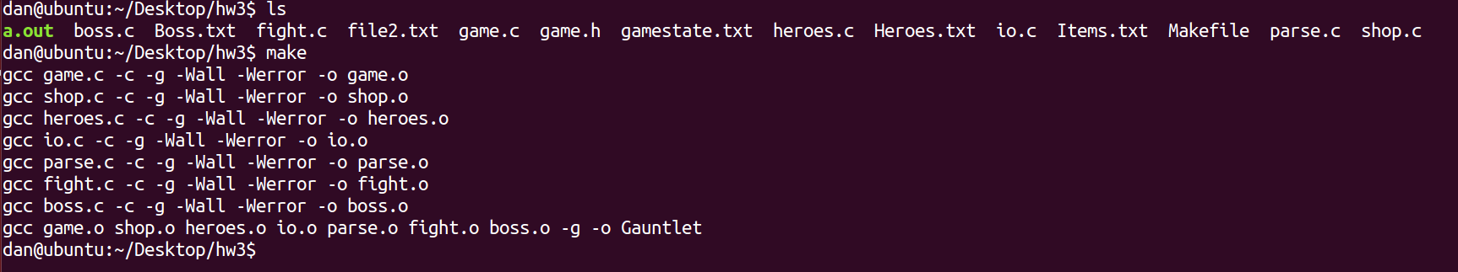
Pictures of sample output
There will not be many descriptions of the sample output, since much of the code behind it is either self-explanatory or already completed.
Note here: the makefile. The makefile successfully compiles all of the .c files into the executable called Gauntlet. The a.out file here can be ignored. A saved file has already been created at this point for demonstration purposes; nothing has changed from HW1 and HW2.

Slide 7
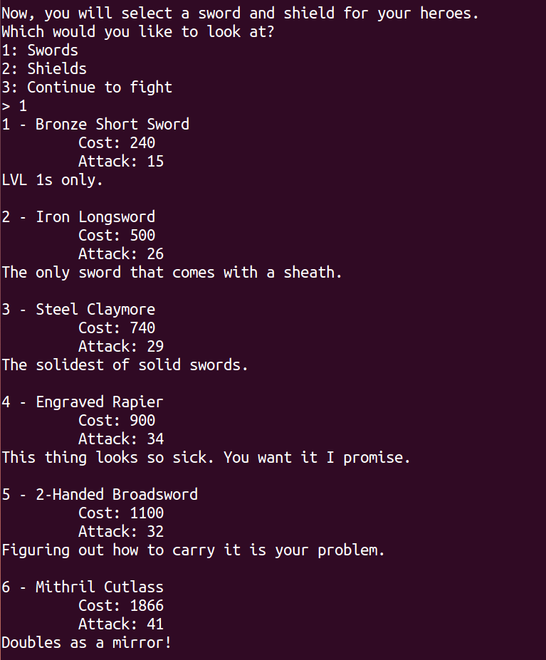
Notice the names and the descriptions of the items. All of the data is still the same as before, except now the names have nice spacing, and the descriptions have been added. This is a result of the parsing you will complete.

Slide 8
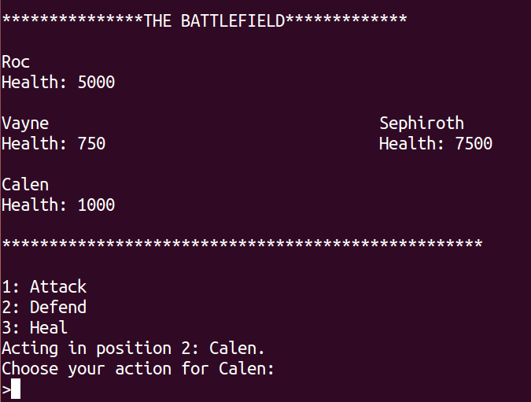
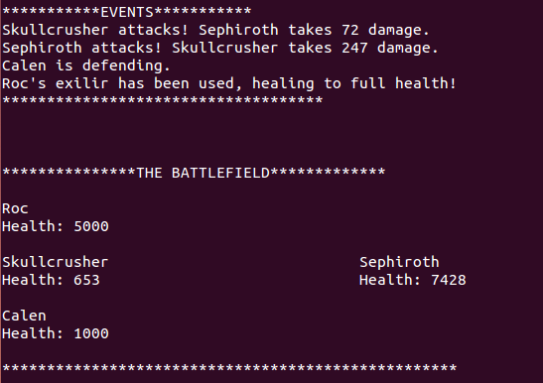
This shows how the fight is taking place. All the logic for this has been done for you; you are simply putting together the data structure that is the boss. The key here is that the game progresses as it should, with no seg faults. This is your first hint to knowing if your code works. The second is seeing that the name and health of the boss is correct. The final hint at this point is seeing that the boss attacks three times, then defends three times. This means that the correct node was found for the first set of actions the boss will take.
When the fight is over, the fight should end cleanly, so it will display a message and go back to the main menu. This is a small hint that your free worked, because there were no double frees, seg faults, etc that happened.
Later on, more instructions will be released to you to thoroughly test your BST, so keep an eye out for this.
…

Slide 9
Things to note
Once you have completed the HW, it is yours to expand, change, improve, etc. It’s public domain, but don’t make it public to your classmates until the deadline has passed
Most of the code you write will affect things behind the scenes. You are encouraged to write your own functions to test your code, but you will be provided with test code later.
As with the test code, you will get submission instructions later as well. Stay tuned!

